Slide 1
Credit Default Detector
Joel Choe
Amogh Gupte
Chintan Mehta
Amit Rajwani

Slide 2
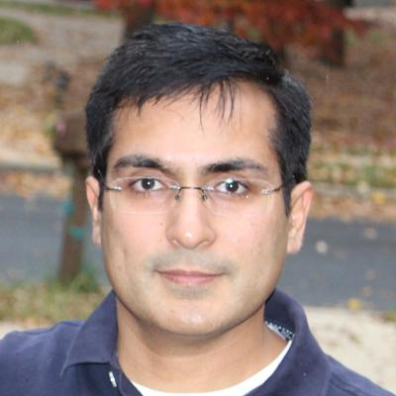
The Team
Joel Choe
Associate on the OTC Derivatives team within Basel Measurement & Analytics
First got interested in data/analytics because of fantasy basketball
Favorite Quote: "You come at the king, you best not miss." - Omar Little from "The Wire"
Chintan Mehta
Chintan has been with JP Morgan Chase more than 8 years and currently working as Strategic Business Analyst with CCB Remediation and Corrections team. I like to travel and explore new places, listening classical Indian music and Bollywood songs and watching movies.
Amogh Gupte
Amogh has been with JP Morgan for the last 12 years as a Java developer in the corporate tech space. He loves hiking spending time with kids.
Amit Rajwani
Amit works in CCB Credit Card Technology for the C3 Authorizations Platform as an Agility Lead. He has been with the firm for 8 years and likes to travel and be outdoors with nature.

Slide 3
Executive Summary
In 2019 JP Morgan reported $5.6 billion net charge-offs.
Our aim is to build a scalable, automated solution to predict defaults.
Our best model (with open-sourced data) was able to catch about 65% of the defaults.
AI Canvas : Using Machine Learning for Credit Card Loan Approval Decisions
Investigate use of machine learning to see what insights and potential benefits can be created when applied to the loan approval process
Looking for more nuance than traditional decision-making process based on credit history/score that maximizes revenue
Made use of dataset via Kaggle containing information about credit card loan transactions (166 attributes and over 300k records)
Notes:
Source: JPMC annual report 2019.
Dataset
The dataset we selected from Kaggle contains information about credit card loan transactions from a credit risk perspective. It's a large dataset containing 122 attributes and over 300K records pertaining to the customer and loan. We also have a target variable that specifies whether the loan was good or default
Why this Dataset
The consumer lending line of business @ JPMC is in the business of lending money to customers for loans, credit cards, mortgage, etc. and a model like this which can predict potential defaults would be immensely helpful in making lending decisions. It could also be used to help JPMC identify and train their customers for credit discipline to avoid potential defaults. Since the dataset is something we could relate to and have some domain knowledge we selected it for our Capstone project
Solution Approach
This is a supervised classification problem since we are using existing features and target variable to first train the model on a subset of data and then evaluate the model's performance on the test data. We would pick the model that best meets the criteria of accuracy and performance. The aim is to use the data to come up with a classification model, to approve or reject the loan request by building a scalable, repeatable service to give real time approval decisions.

Slide 4







The AI Canvas
This data set is uploaded in order to get the insights of Credit card Defaultees based on the respective attributes. The consumer lending line of business @ JPMC is in the business of lending money to customers for loans, credit cards, mortgage, etc. and a model like this which can predict potential defaults would be immensely helpful in making lending decisions. The aim of the project is to provide this service, based on a ML model, which will be repeatable, scallable and retrainable.
Prediction
Judgment
Action
Outcome
Predict whether an applicant will default
For this use-case catching the default case is more important, as if a client defaults the firm will loose the whole credit amount.
A customer’s application can be approved or declined based on the inputs provided.
Recall on the testing data is the main criteria here
Training
Input
Hyper Parameter tuning
To over come the skewed input data we performed over sampling.
We reduced the inputs to the model to 7 from 166 odd inputs.
DAYS_EMPLOYED
DAYS_BIRTH
AMT_ANNUITY
AMT_CREDIT
AMT_INCOME_TOTAL
AMT_GOODS_PRICE
AMT_REQ_CREDIT_BUREAU_YEAR
With best results from:
Constant: 1.0
Penalty: none
Solver: sag
A customer’s application can be approved or declined based on the inputs provided. AI will not replace the staff, but will help in better decision making and tremendously improve the decision timing. Also it will bring consistency in the decision making process and provide additional scalability and easy maintainability. The staff feedback can help improve the AI.
© Agrawal, Gans, Goldfarb 2019
Notes:
Delete in final ppt

Slide 5
Key observations of the dataset & Pre-processing
This is an imbalanced dataset. There are far more loans that were repaid on time than loans that were not repaid
Mean employment tenure is skewed due to outliers and needs to be filtered to get a better model
The Risk of Failure to repay was higher in the younger age group as compared to older applicants. As the age increased the risk decreased
We handled missing data, data errors and outliers
A large number of attributes were dropped since they either provided duplicate information or were insignificant in model performance

Slide 6
Input
Column Name | Column Description | Weight
AMT_ANNUITY | Loan annuity | 0.14
AMT_CREDIT | Credit amount of the loan | 1.21
AMT_GOODS_PRICE | For consumer loans it is the price of the goods for which the loan is given | -1.41
AMT_INCOME_TOTAL | Income of the client | -0.09
AMT_REQ_CREDIT_BUREAU_YEAR | Number of enquiries to Credit Bureau about the client one day year (excluding last 3 months before application) | 0.09
DAYS_BIRTH | Client's age in years at the time of application | 0.15
DAYS_EMPLOYED | How many months before the application the person started current employment | 0.24

Slide 7
Model Selection
With our project:
A false positive will mean that the firm will lose the business of a potential 'good' client.
A false negative will result in the firm losing money due to loaning to a defaulter client.
From the above we believe that a false negative will have a higher impact to model performance. We have compared the below models and come up with Logistic Regression model as it will give us the best recall for defaulters in test data. KNN also has the same recall, but it has a higher false positive rate than Logistic Regression.
Comparing our chosen model to the baseline (marking all applicants as not default):
Baseline Accuracy Score : 0.9159
Our Best Accuracy Score : 0.91527
Baseline Recall Score : 0.0
Model Recall Score : 0.658
Name | Accuracy | Recall | precision
Decision Tree | 60.6% | 57.9% | 52.5%
Random Forest | 91.4% | 0.7% | 91.2%
Logistic | 56.3% | 65.8% | 53.5%
KNN | 84.8% | 10.8% | 85.1%
XGBoost | 89.5% | 7.1% | 87.4%
As it can be seen our model gives considerably better Recall over the baseline for defaulter case.

Slide 8
Hyper Parameter tuning
We ran the various classifiers through different configurations
For Logistic Regression (Chosen solution), we tried:
Constant: [1.0, 0.5, 0.2, 1.5]
Penalty: [L2, none]
Solver: [newton-cg, lbfgs, liblinear, sag, saga]
With best results from:
Constant: 1.0
Penalty: none
Solver: sag
Notes:
C - To solve this, as well as minimizing the error as already discussed, you add to what is minimized and also minimize a function that penalizes large values of the parameters. Most often the function is λΣθ_{j}², which is some constant λ times the sum of the squared parameter values θ_{j}². The larger λ is the less likely it is that the parameters will be increased in magnitude simply to adjust for small perturbations in the data. In your case however, rather than specifying λ, you specify C=1/λ.
Penalty: loss function
L1: L1-norm loss function is also known as least absolute deviations (LAD), least absolute errors (LAE). It is basically minimizing the sum of the absolute differences (S) between the target value (Y_{i}) and the estimated values (f(x_{i}))
L2: L2-norm loss function is also known as least squares error (LSE). It is basically minimizing the sum of the square of the differences (S) between the target value (Y_{i}) and the estimated values (f(x_{i})
Sag: SAG solver for Ridge and LogisticRegression. SAG stands for Stochastic Average Gradient: the gradient of the loss is estimated each sample at a time and the model is updated along the way with a constant learning rate.

Slide 9
Demo & Repo
https://slackers-ml.herokuapp.com/
https://github.com/amoghugupte/Slackers-Capstone
Data set is from Kaggle : https://www.kaggle.com/mishra5001/credit-card

Slide 10
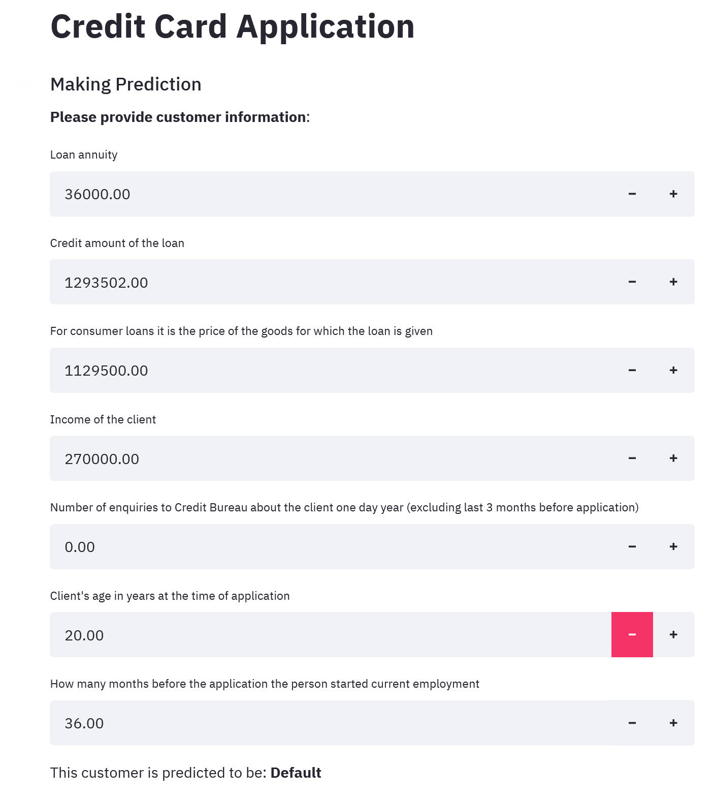
Demo
Notes:
Not Default:
"AMT_ANNUITY" : [35698.5],
"AMT_CREDIT" : [1293502.5],
"AMT_GOODS_PRICE" : [1129500],
"AMT_INCOME_TOTAL" : [270000],
"AMT_REQ_CREDIT_BUREAU_YEAR" : [0],
"DAYS_BIRTH" : [-16765],
"DAYS_EMPLOYED" : [-1188]
Default:
"AMT_ANNUITY" : [24700.5],
"AMT_CREDIT" : [406597.5],
"AMT_GOODS_PRICE" : [351000],
"AMT_INCOME_TOTAL" : [202500],
"AMT_REQ_CREDIT_BUREAU_YEAR" : [1],
"DAYS_BIRTH" : [-9461],
"DAYS_EMPLOYED" : [-637]

